Slide 1




PROBLEM SOLVING PROCESS
Class X
lab 7

Slide 2
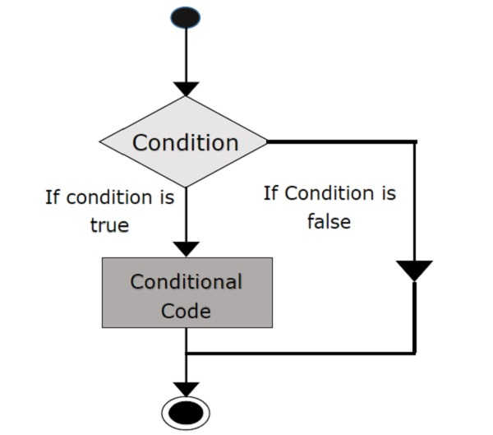
What are if...else statement?
Decision making is required when we want to execute a code only if a certain condition is satisfied.

Slide 3
Syntax of if...else
if test expression: Body of if else: Body of else

Slide 4
Syntax of if...elif...else
if test expression: Body of if elif test expression: Body of elif else: Body of else

Slide 5
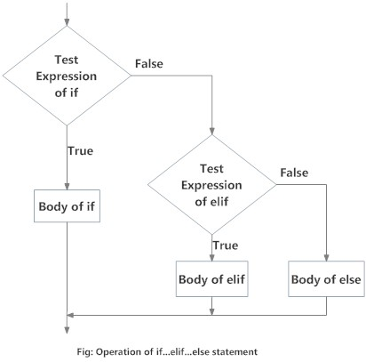
Flowchart of if...elif...else

Slide 6



